Slide 1
Introduction to Psychology
Delivered by
Amna Nisar
Clinical Psychologist
Speech and language Pathologist

Slide 2
Personality

Slide 3
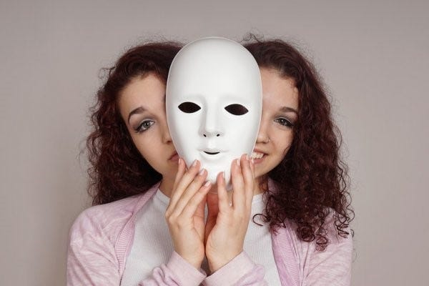
Definition
Personality has been derived from the Latin word “persona” which means “mask” used by the actors to change their appearance. It is the combination of an individual thoughts, characteristics, behaviors, attitude, idea and habits.

Slide 4
Definitions by famous Psychologists
Macionis define as “It is the constant pattern of thinking, feeling and acting.”
Ogburn and Nimkoff define it as the “totality of sentiments, attitudes, idea, habits, skills and behaviors of an individual.”

Slide 5
What Is Personality?
As a professional term in psychology, personality is a person's unique patterns of thought, emotion, and behavior. This means that personality is all the characteristics of who we are as unique individuals.
When psychologists study personality, they usually conduct two different kinds of research.
1-)How and why people differ in a particular characteristic or group of characteristics like humor, being outgoing, aggression, and more.
2-)How the different traits in a person's personality work together to create who they are and how they interact with the world around them.

Slide 6
Determinants of personality
Determinants of personality
Biological factors
Family factors
Situational factors
Cultural factors

Slide 7
Variables Influencing Individual Behavior
Genetics
Environment
Childhood experiences
Cultural influences
Socialization
Biological factors (hormone levels, general health)
Psychological factors
Life choices and goals
Personal relationships

Slide 8
Variables Influencing Individual Behavior (organizational level)
P
The Person
Skills & abilities
Personality
Perceptions
Attitudes
Values
Ethics
E
The Environment
Organization
Work group
Job
Personal life
B
Behavior
Notes:
4
4
4
5

Slide 9
Types of Personalities by Carl Jung (offering insights into individual differences in behavior, cognition, and emotion regarding social interaction and stimulation preferences)

Slide 10
1. Extrovert Personality
This type has the tendency to live mostly outside the like to live with others. Those individuals are highly socialized and have contact with outside people in the society. They want to join other groups who are more in number.

Slide 11
2. Introvert Personality
Introvert is opposite to extrovert. Those people are always live alone in their rooms and do not want to go outside. They have their own imaginary world. They are teachers, scientists, thinkers and philosophers.

Slide 12
3. Ambivert Personality
Between extrovert and introvert personalities there is a third one type called ambivert. People belonging to this type enjoy both the groups and attend them. They have middle mind and want to live in both parties. Sometimes they join outside people but sometimes they live in their own rooms.

Slide 13
Big Five Personality Traits by Lewis Goldberg and McCrae & Costa

Slide 14
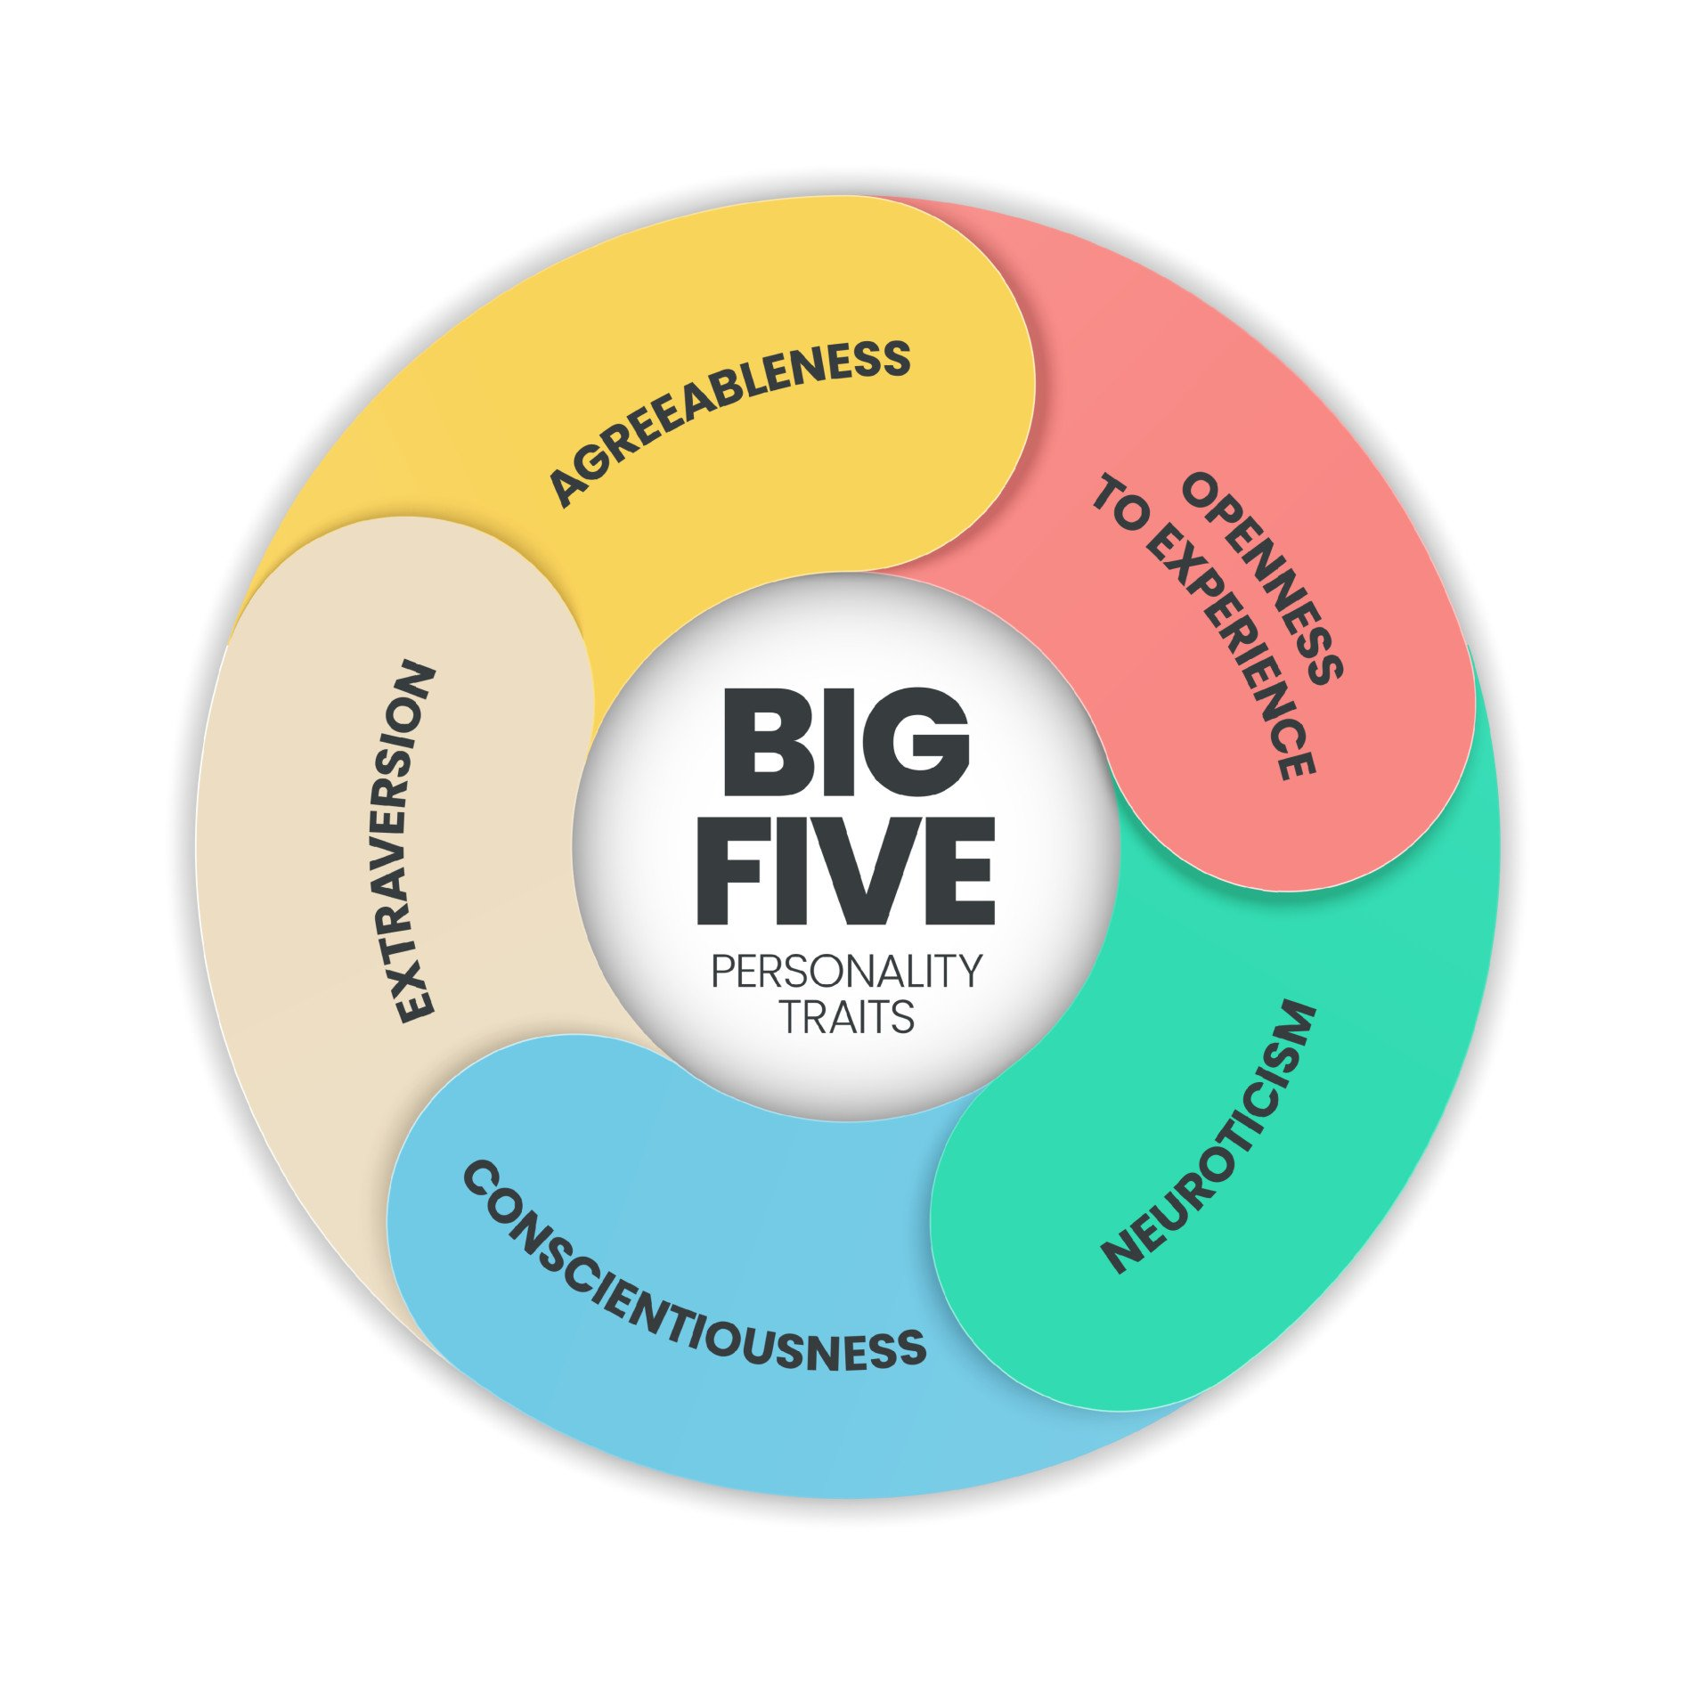

Slide 15
Openness
Openness is shorthand for "openness to experience." People who are high in openness enjoy adventure. They're curious and appreciate art, imagination and new things. The motto of the open individual might be "Variety is the spice of life."

Slide 16
Conscientiousness
People who are conscientious are organized and have a strong sense of duty. They're dependable, disciplined and achievement-focused. You won't find conscientious types jetting off on round-the-world journeys with only a backpack; they're planners.

Slide 17
Extraversion
Extraversion versus introversion is possibly the most recognizable personality trait of the Big Five. The more of an extravert someone is, the more of a social butterfly they are. Extraverts are chatty, sociable and draw energy from crowds. They tend to be assertive and cheerful in their social interactions.

Slide 18
Agreeableness
Agreeableness measures the extent of a person's warmth and kindness. The more agreeable someone is, the more likely they are to be trusting, helpful and compassionate. Disagreeable people are cold and suspicious of others, and they're less likely to cooperate.

Slide 19
Neuroticism
They worries about everything, obsesses over germs and disease and once quits a job because his anxiety over not having access to a private bathroom is too overwhelming. People high in neuroticism worry frequently and easily slip into anxiety and depression.

Slide 20
Type A vs Type B by Meyer Friedman and Ray Rosenman

Slide 21
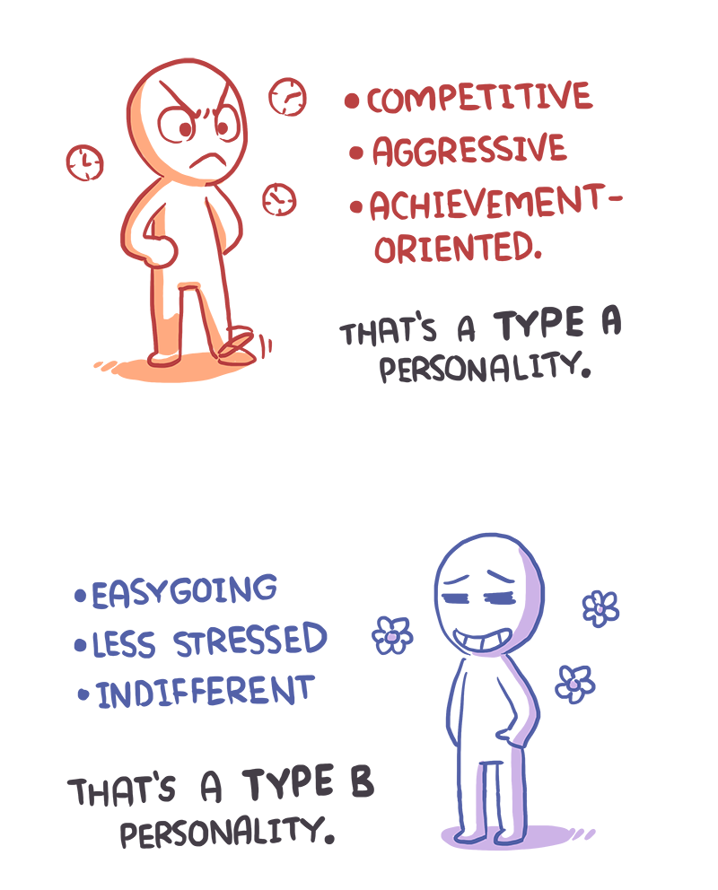
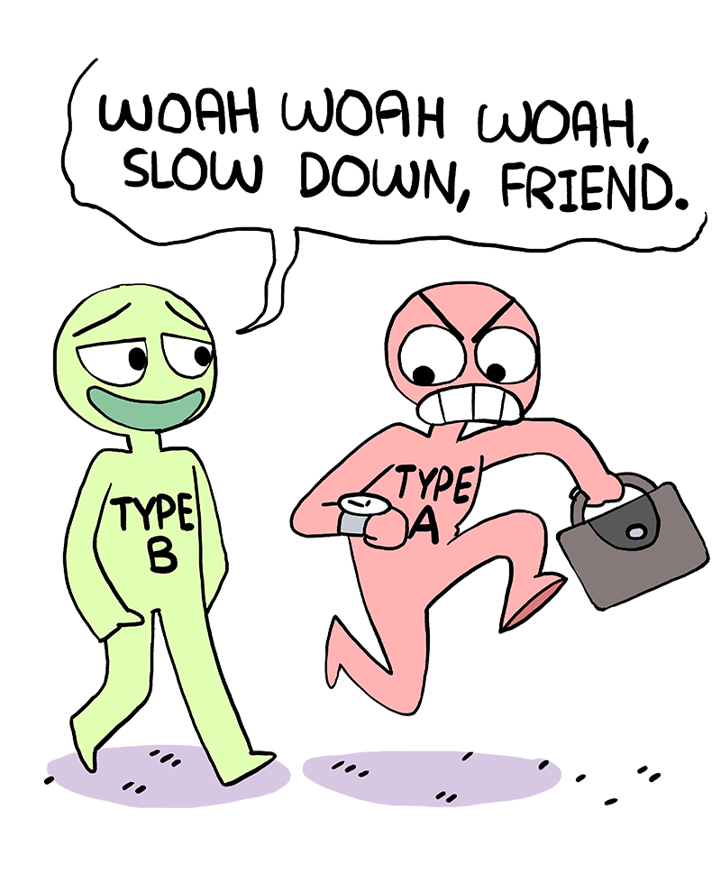
TYPE A VS TYPE B
Type A
Type B

Slide 22
Can Personality Change ?

Slide 23
Maybe. A study published in the January 2017 published research papers and found that personality may be altered through therapy. "For the people who want to change their spouse tomorrow, which a lot of people want to do, I don't hold out much hope for them," said study researcher Brent Roberts, a social and personality psychologist at the University of Illinois. However, he continued, "if you're willing to focus on one aspect of yourself, and you're willing to go at it systematically, there's now increased optimism that you can affect change in that domain."

Slide 24
Personality Assessment
Interview: Face-to-face meeting designed to gain information about someone’s personality, current psychological state, or personal history
Unstructured Interview: Conversation is informal, and topics are discussed as they arise
Structured Interview: Follows a prearranged plan, using a series of planned questions
Direct Observation: Looking at behavior

Slide 25
Other Types of Personality Assessments
Behavioral Assessment: Recording the frequency of specific behaviors
Situational Test: Real life situations are simulated so that someone’s spontaneous reactions can be recorded
In-Basket Test: Simulates decision-making challenges that executives face
Basket full of memos is given to applicant, and applicant must act appropriately as quickly as possible
Leaderless Group Discussion: Test of leadership that simulates group decision making and problem solving

Slide 26

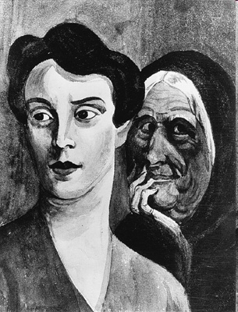
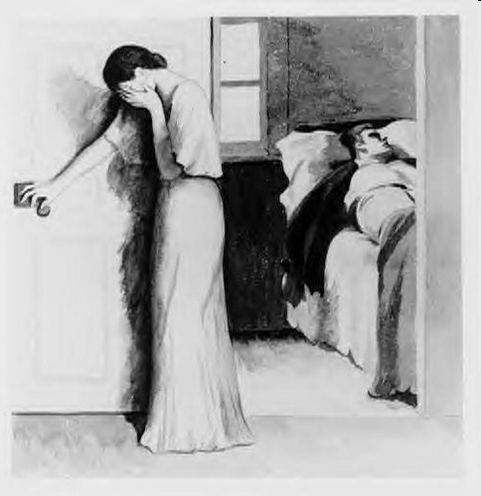
Projective tests
The Rorschach Ink blot Test
Thematic Apperception test

Slide 27
Personality Characteristics in Organizations
Positive Affect - an individual’s tendency to accentuate the positive aspects of oneself, other people, and the world in general
Negative Affect - an individual’s tendency to accentuate the negative aspects of oneself, other people, and the world in general
Notes:
13
13
13
12

Slide 28
Personality Characteristics in Organizations
A strong
situation can
overwhelm the effects
of individual personalities
by providing strong cues
for appropriate
behavior
Notes:
14
14
14
13

Slide 29
Personality Characteristics in Organizations
Strong
personalities
will dominate
in a weak
situation
Notes:
15
15
15
14

Slide 30
Personality Development Tips

Slide 31
Should be a better listener
Good conversation
Be positive in outlook and attitude
More reading and building interest
Should be a good courteous
Interaction with new people
Helpful to other people
Give respect if you want respect
Confident about yourself

Slide 32
Describe Your Behavior
At home with parents
In class
At a sporting event
Reading a book
In dining hall at meal time
Talking with a good friend
Choose 2 for each: Selfish Energetic Demanding Polite Reserved Helpful

Slide 33
Always be Thankful
Thank you

